Slide 1
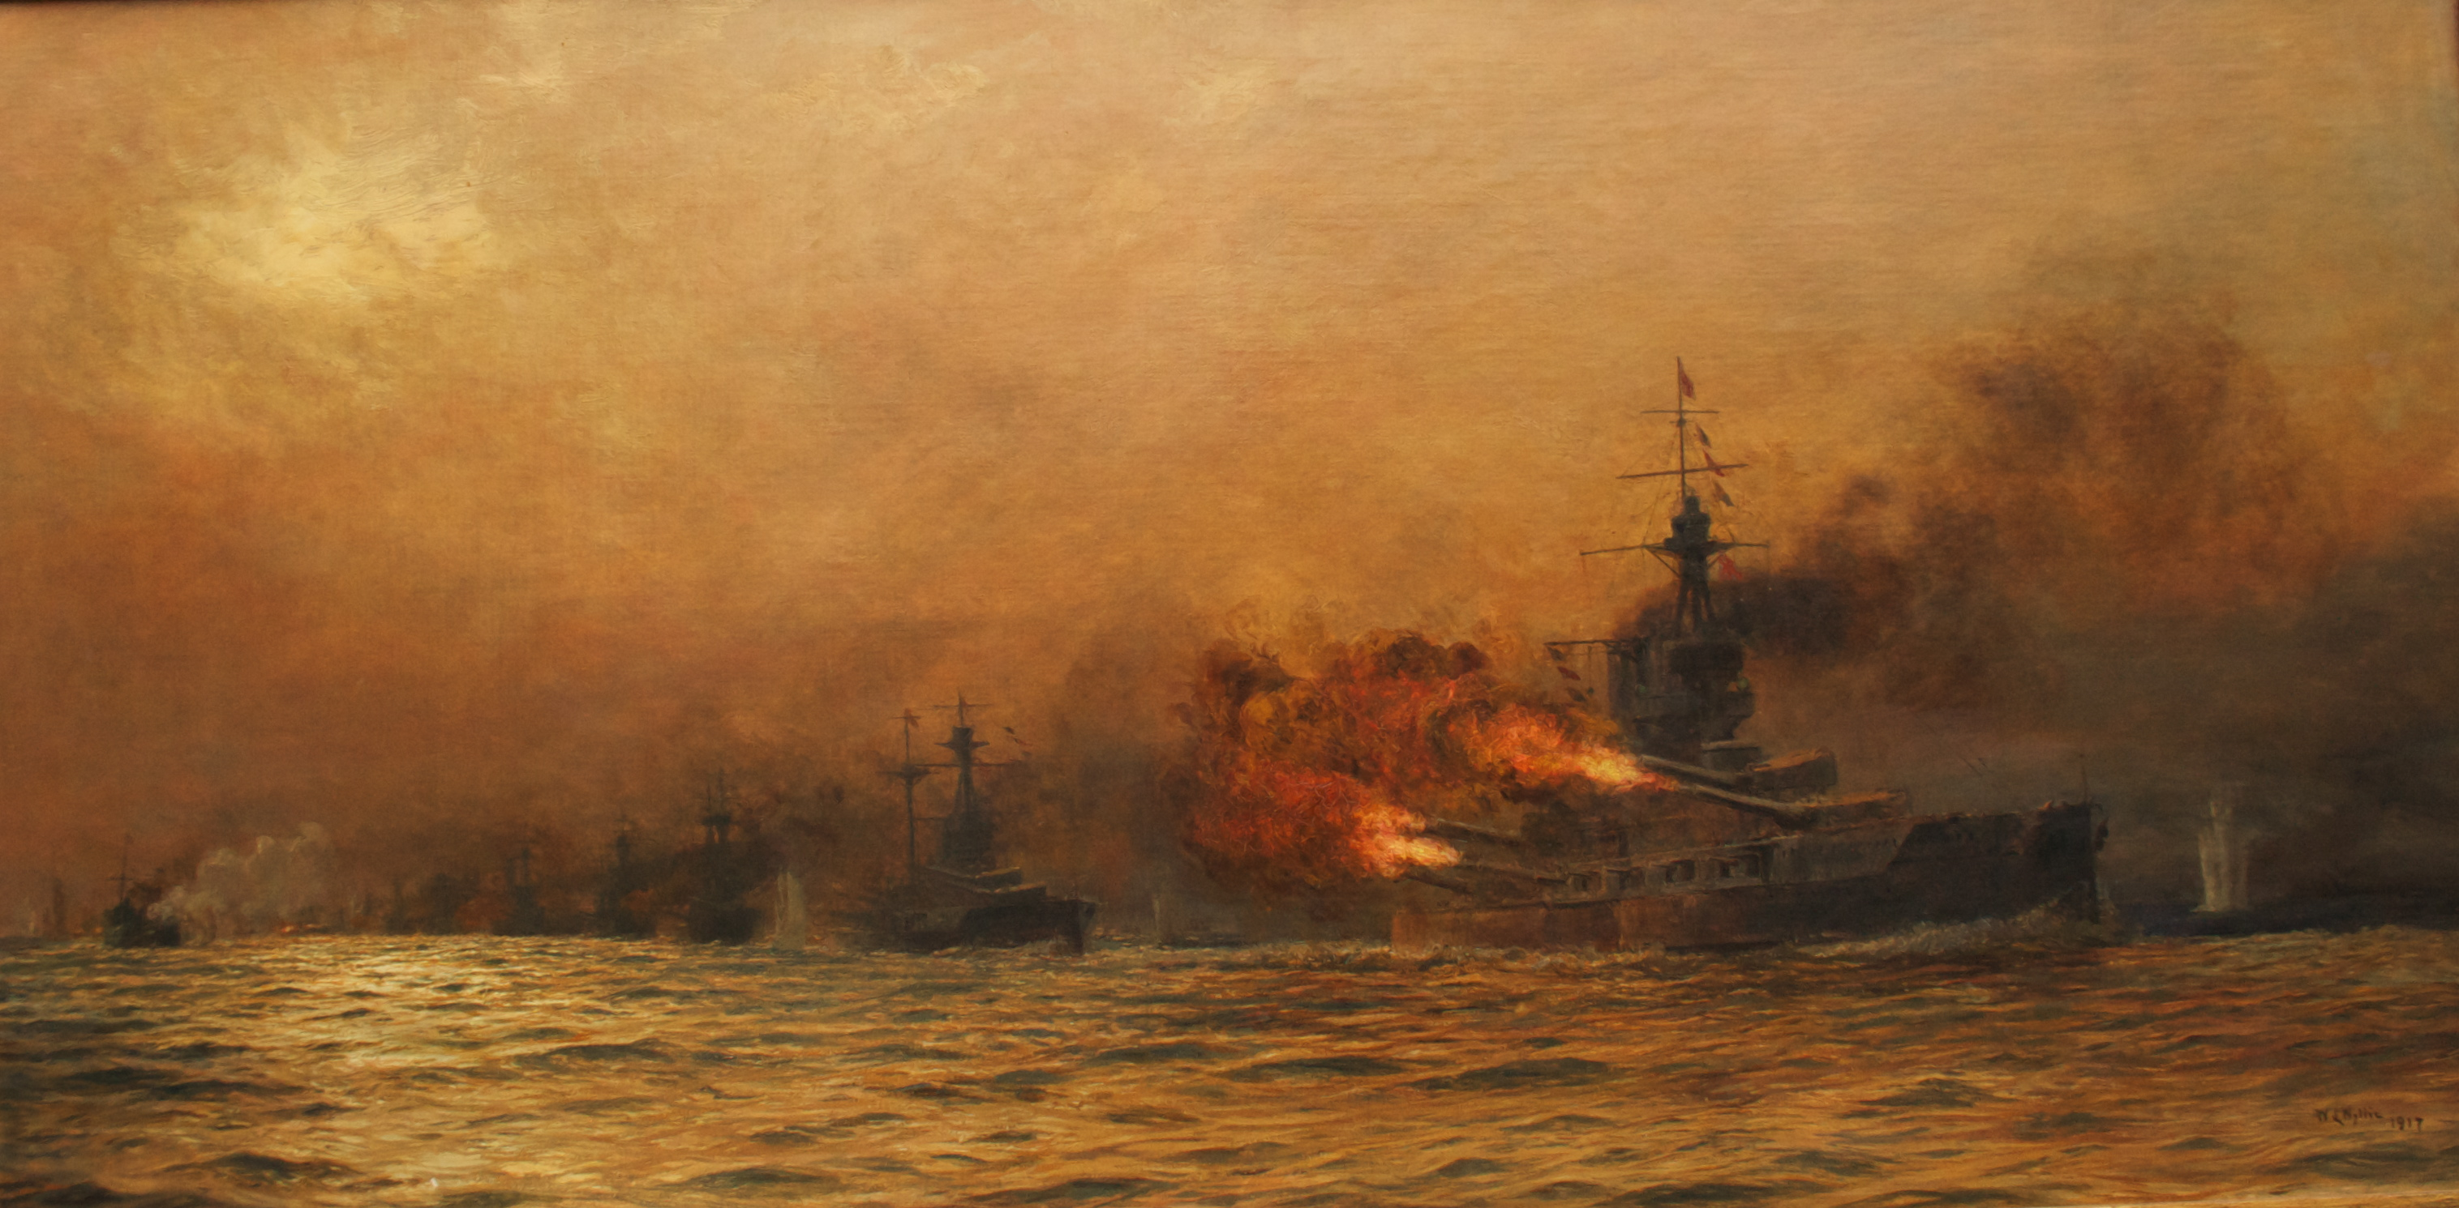
JUTLAND.
A NAVAL ENGAGEMENT THAT CHANGED THE COURSE OF WW1

Slide 2
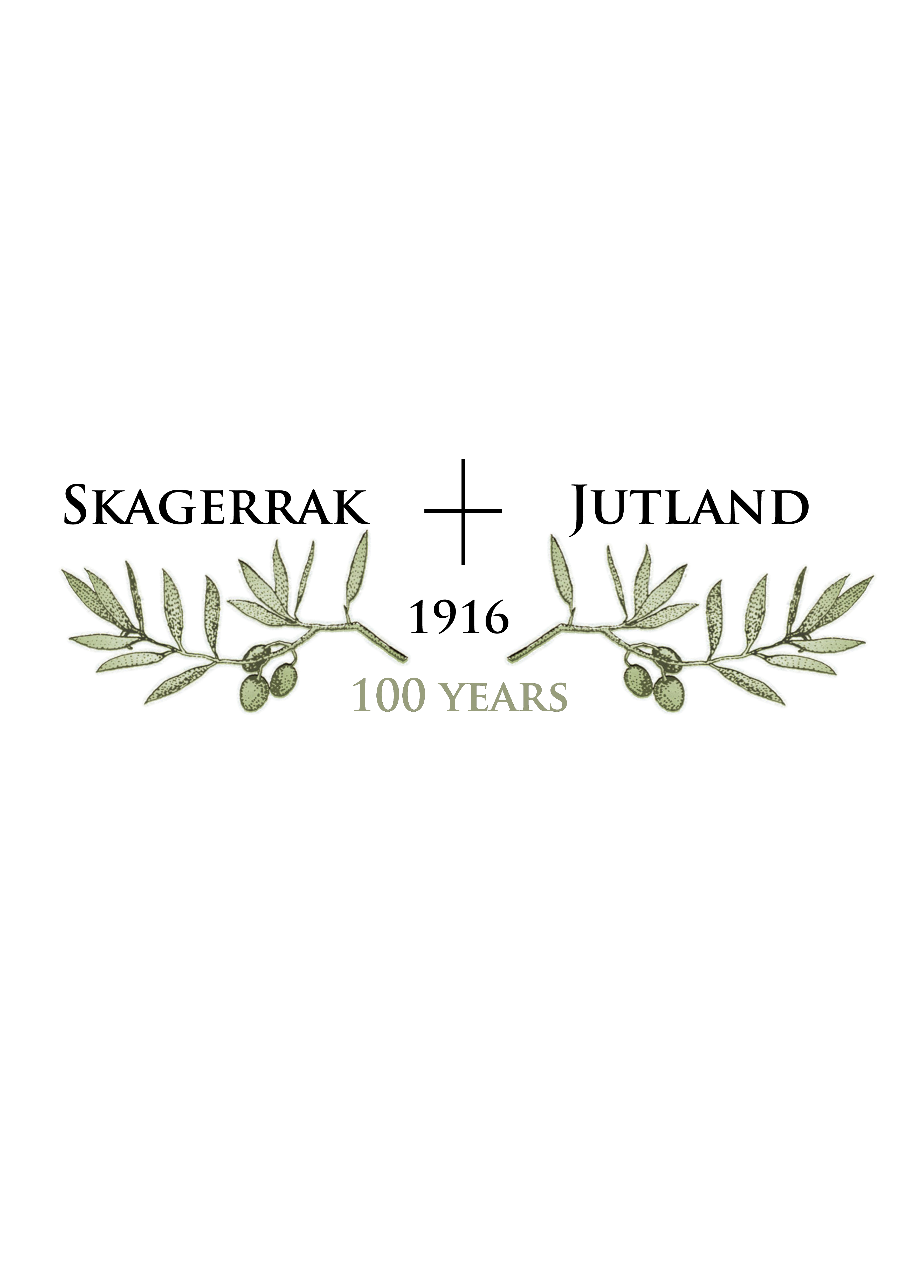

Slide 3
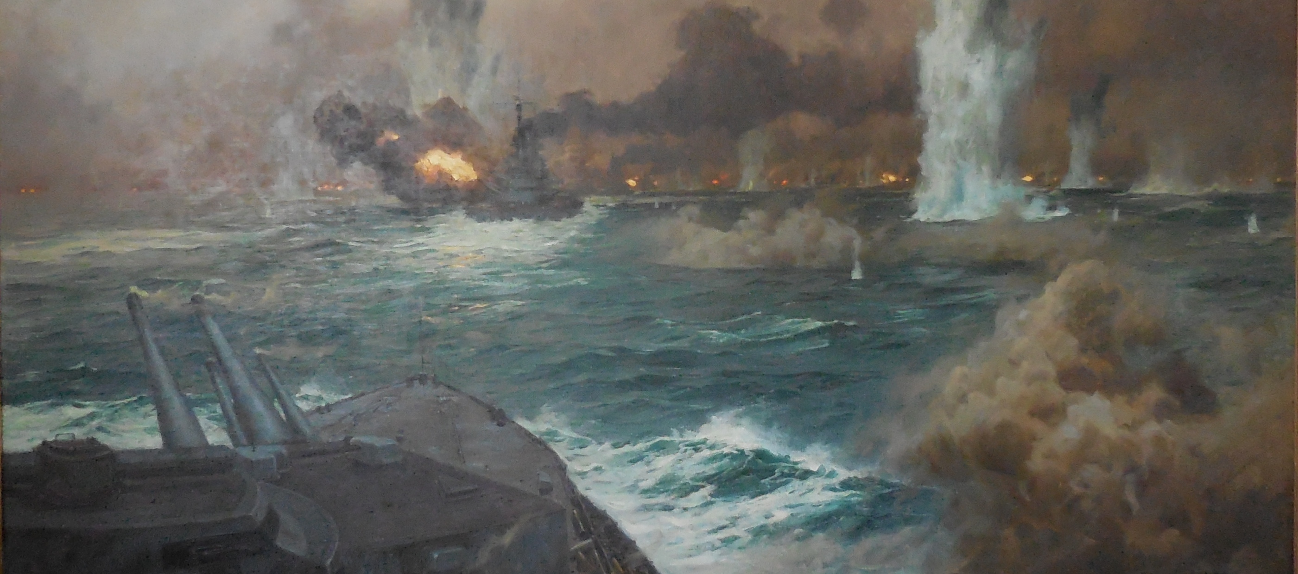
WHAT WAS JUTLAND? - Largest dreadnought naval battle in history
- Fought over 12 hours – from May 31st to June 1st 1916

Slide 4
HOW LARGE WAS JUTLAND? - 249 ships of war - 28 British & 16 German dreadnoughts - 96,000 sailors

Slide 5
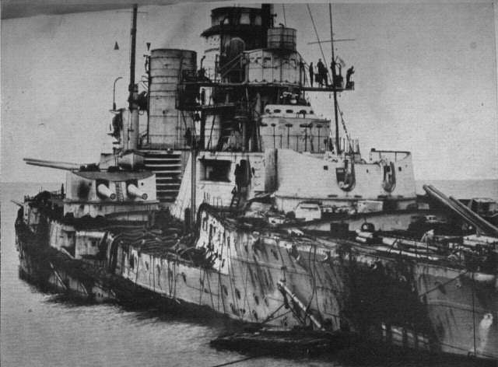
LOSSES HEAVIER FOR THE BRITISH - 5,672 British and 2,115 German sailors killed - Four Admirals killed in action

Slide 6
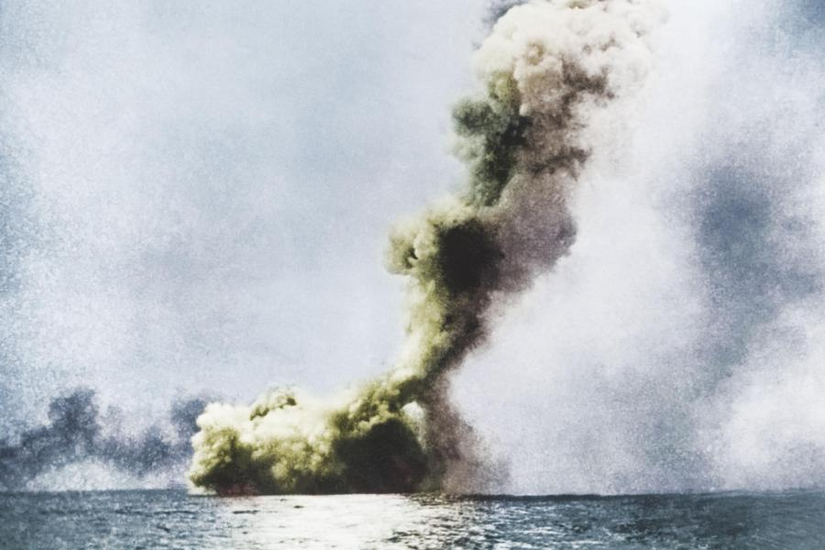
SEARCHING QUESTIONS WERE ASKED - Why had the Royal navy not annihilated its opponent? - Why did British battle-cruisers suffer catastrophic explosions? - What went wrong with British signaling, british ship design, shells etc.?

Slide 7
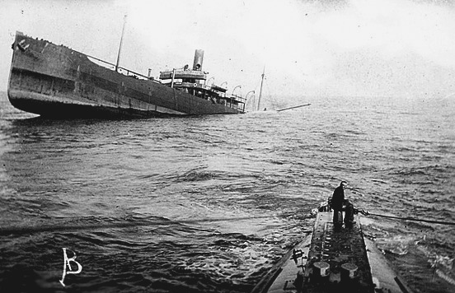
UN-RESTRICTED SUBMARINE WARFARE - Germany would sink any merchant ship in the war zone without warning - April 6th America declared war joining the allied cause - By April, U-boats were sinking or damaging 960,000 tons of merchant shipping a month - Britain was near the end of supplied

Slide 8
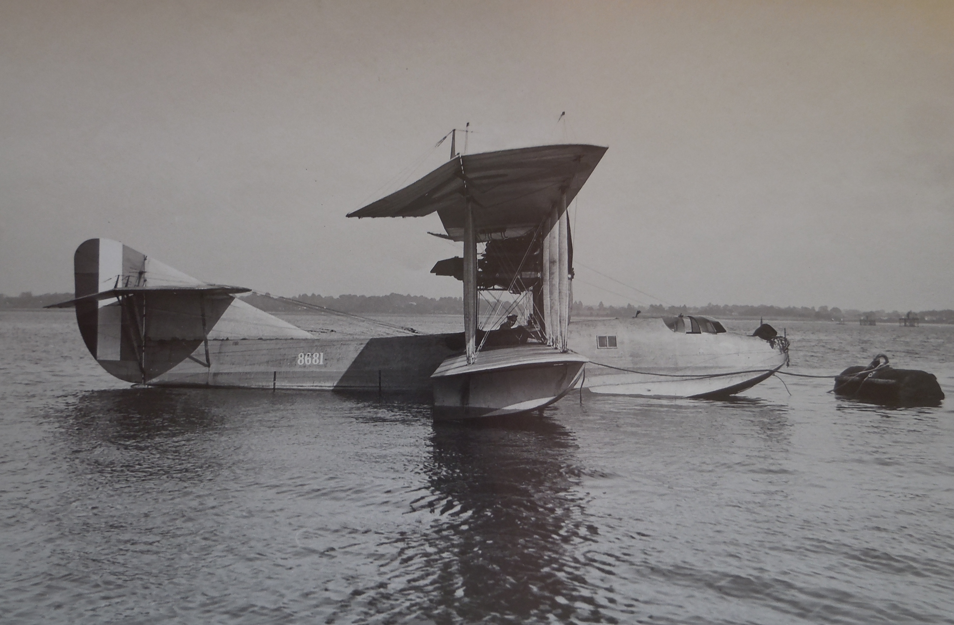
NEW WEAPONS WON BY END 1917 - U.S. destroyers vital for convoy duty - U.S. Flying boats for recon - New mines, a new howitzer launched depth-charge - Early stages of sonar - A huge civilian fleet of patrol boats, disguised & armed merchantmen (Q ships)

Slide 9
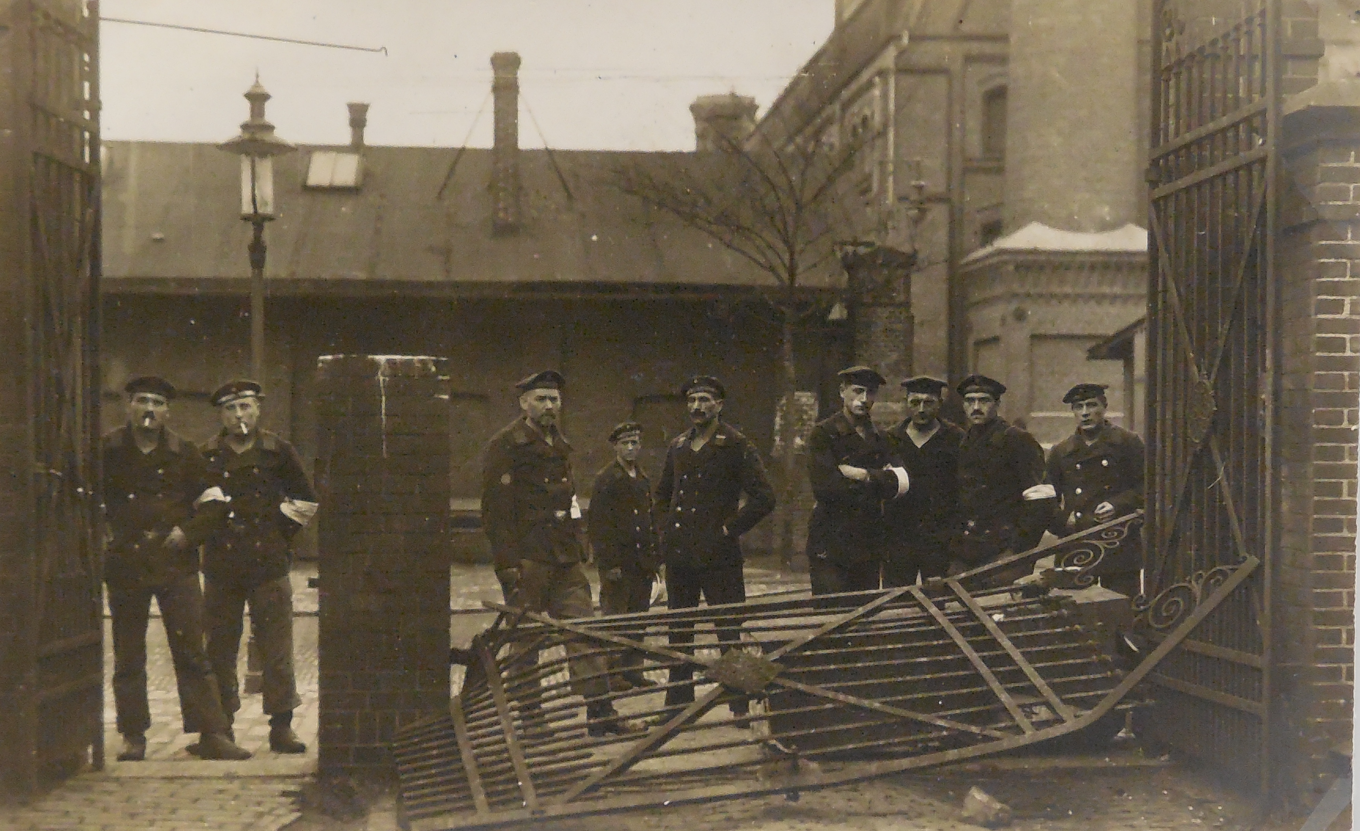
THE GERMAN REVOLUTION - After Jutland the fleet only sortied once - Morale collapsed and the navy mutinied - Germany fell into a larger political revolution

Slide 10
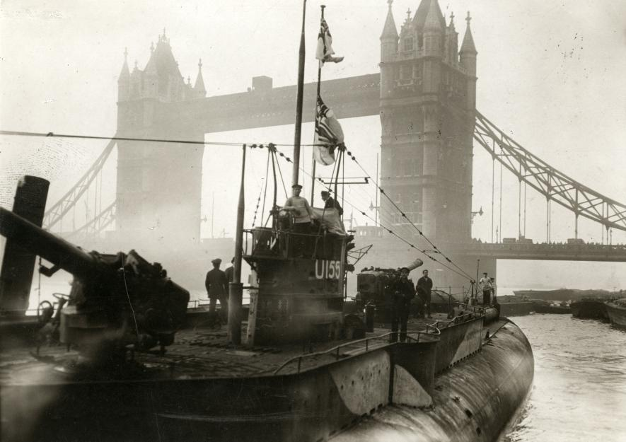
MERCHANT SHIPPING LOSSES DECLINED

Slide 11
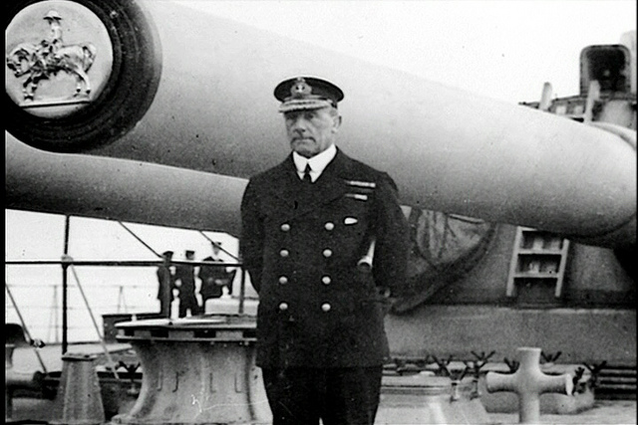
JUTLAND’S OUTCOME - The Royal Navy maintained surface control - The submarine peril was defeated

