Slide 1
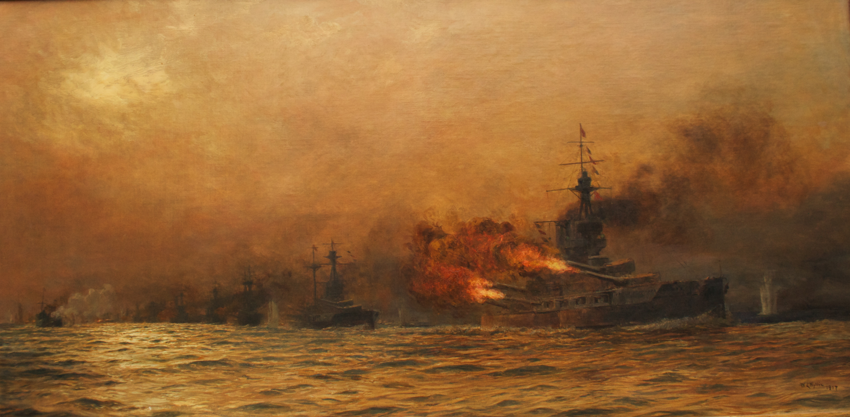
JUTLAND.
THE PHASES OF THE BATTLE OF JUTLAND MAY 31st – JUNE 1st 1916

Slide 2
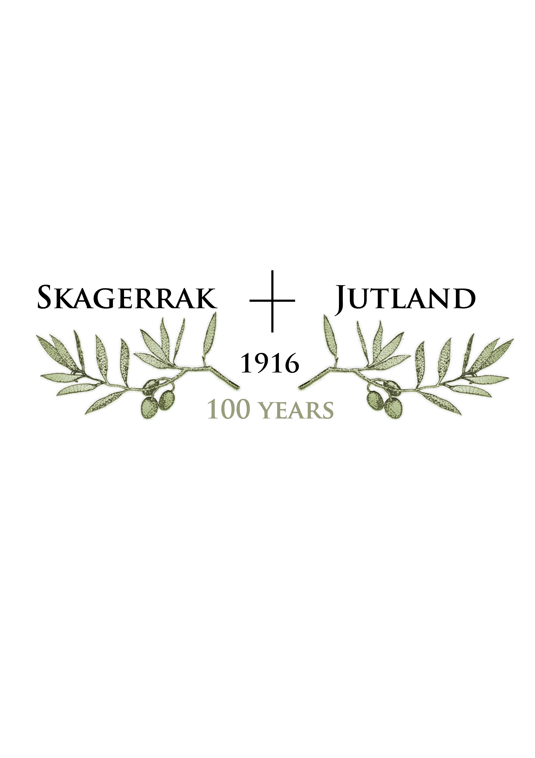

Slide 3
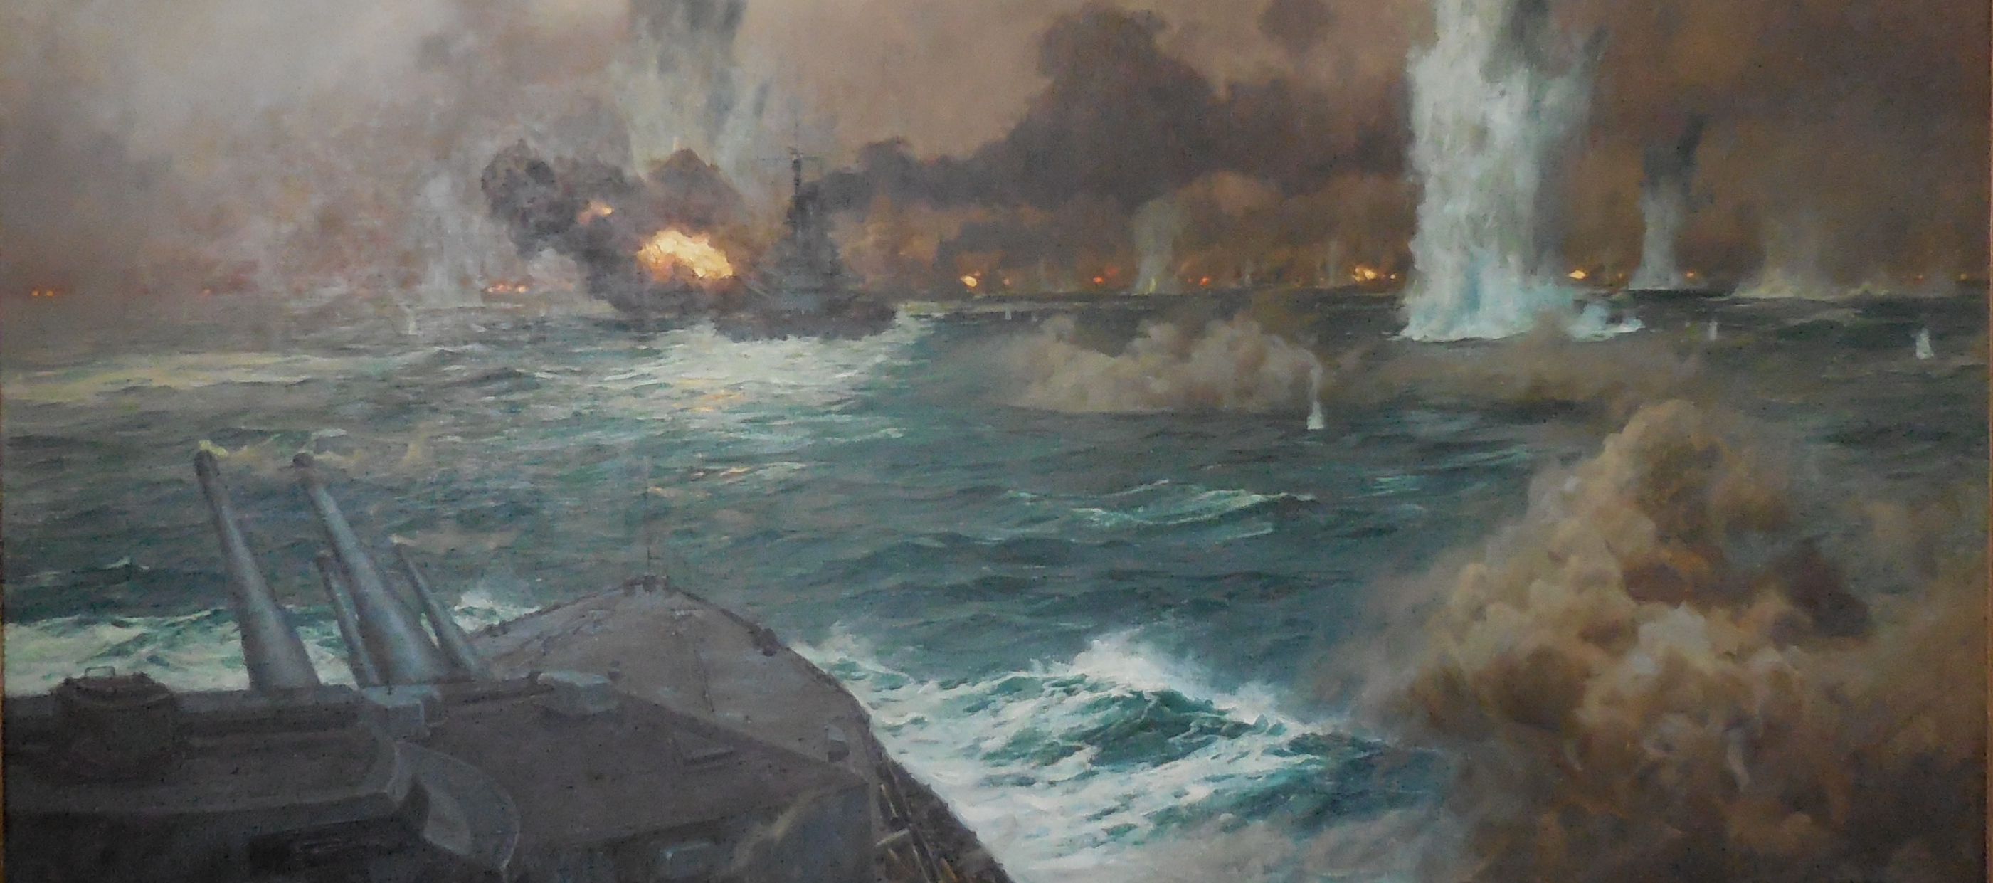
WHAT WAS JUTLAND?
- Largest dreadnought naval battle in history
- Fought over 12 hours – from May 31st to June 1st 1916

Slide 4
HOW LARGE WAS JUTLAND?
- 249 ships of war
- 28 British & 16 German dreadnoughts
- 96,000 sailors

Slide 5
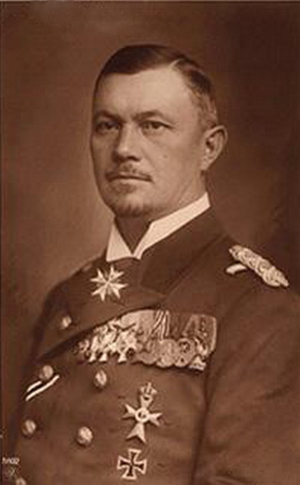
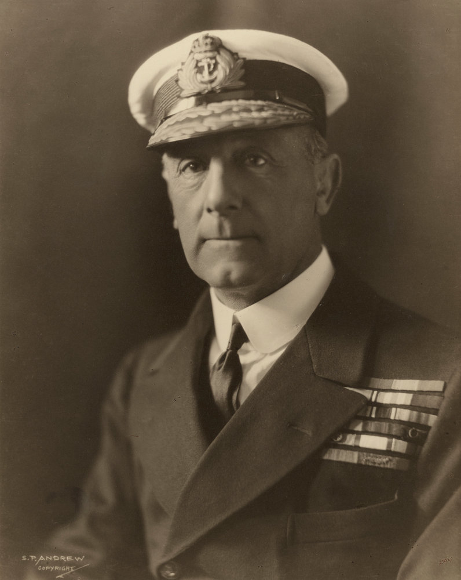
THE CHAPTERS OF THE BATTLE
- 1.The Battle-cruiser action running south
- 2. The Battle-cruisers lead Scheer to Jellicoe
- 3. The British Fleet deployment
- 4. The British Turn Away
- 5. The Night Actions

Slide 6
1. BATTLE CRUISER ACTION
- Beatty: 6 ship Battle-cruiser Fleet & 4 15” battleships
- Hipper: 5 battle-cruisers

Slide 7
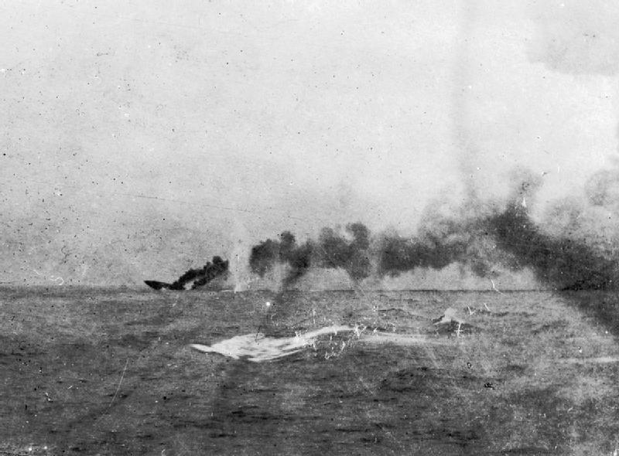
1.BATTLE CRUISER ACTION
- British lose 2 battle-cruisers (HMS Indefatigable and Queen
Mary at 16:01 and 16:26.
- More than 2,000 dead. Only 3 officers and 9 ratings survive the massive magazine explosions

Slide 8
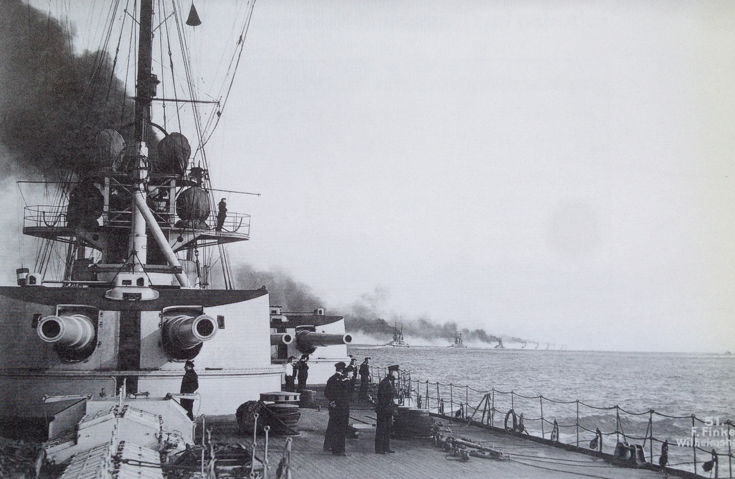
1.BATTLE CRUISER ACTION
- Beatty’s forces spot main German battle fleet coming north to spring the trap and turn around

Slide 9
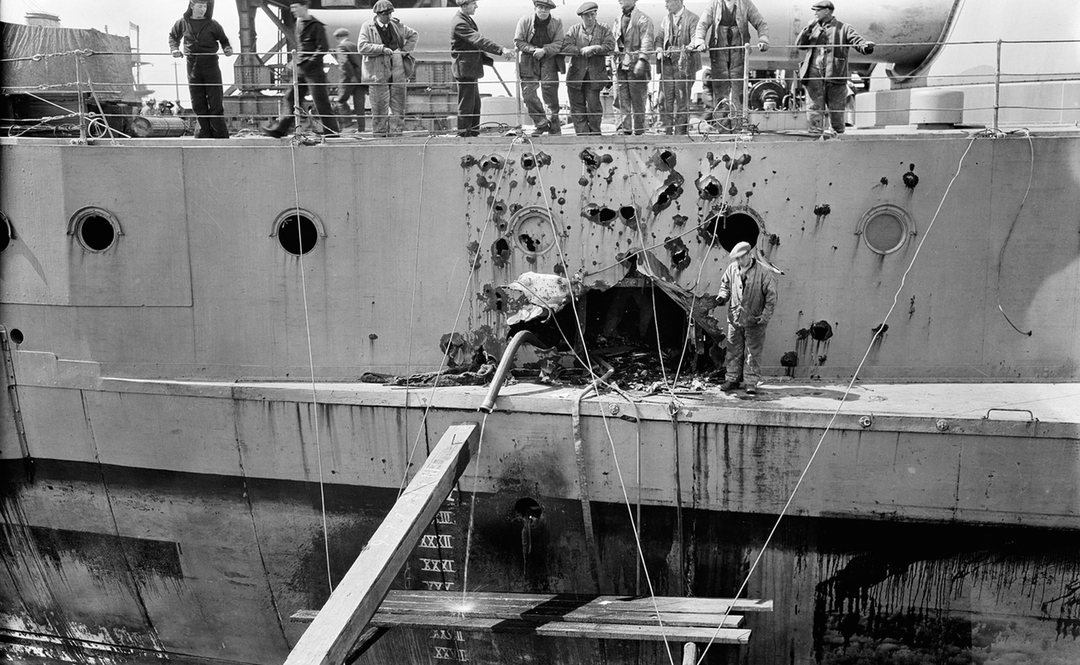
2.BEATTY LEADS SCHEER TO JELLICOE
- Beatty succesfully leads the German main fleet to Jellicoe’s fleet coming south.
- His ships, especially HMS Warspite, take terrific punishment

Slide 10
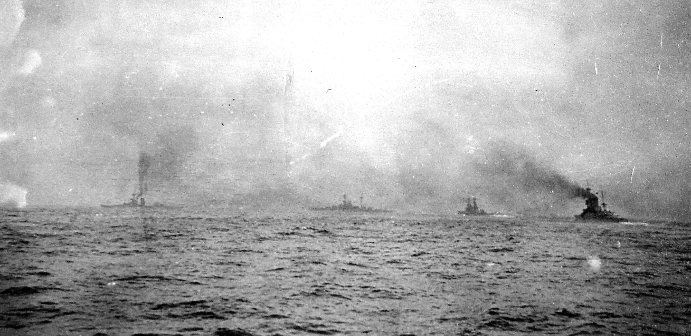
3.THE DEPLOYMENT
- Jellicoe re-structures 24 dreadnoughts into a battle line able to bring all guns to bear
- Does not know where the German main fleet is and visibility is very bad

Slide 11
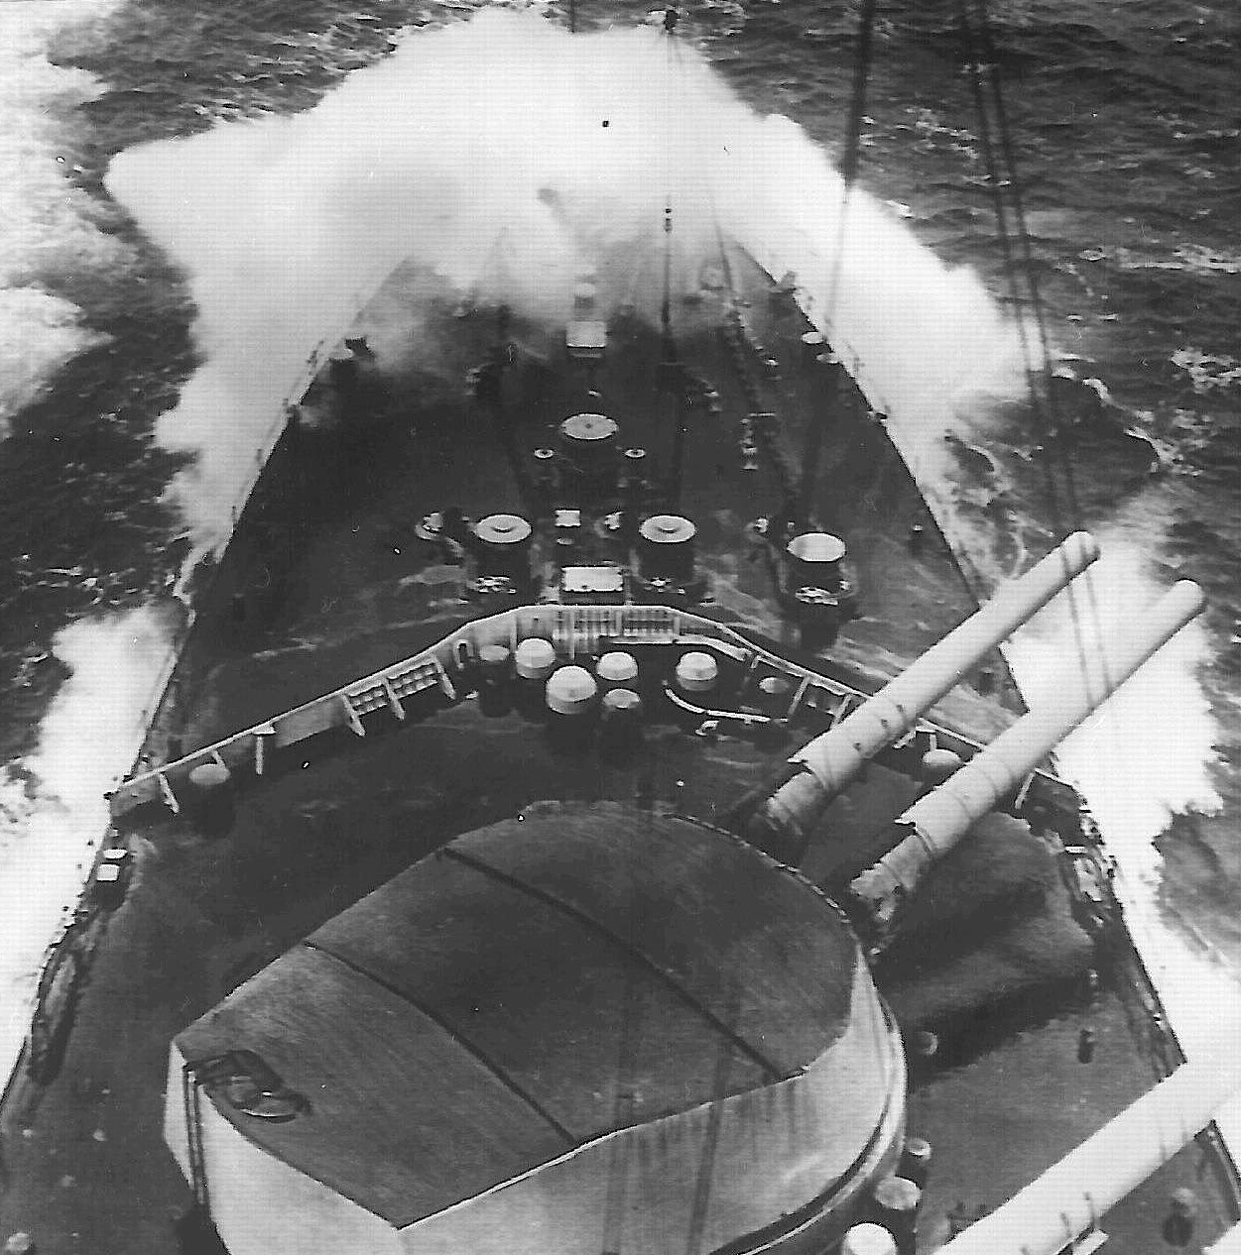
3.THE DEPLOYMENT
- Jellicoe bends the line south catching the
Germans inside the fire of almost 200 guns
- The German ships take huge punishment but manage to turn away and then come back

Slide 12
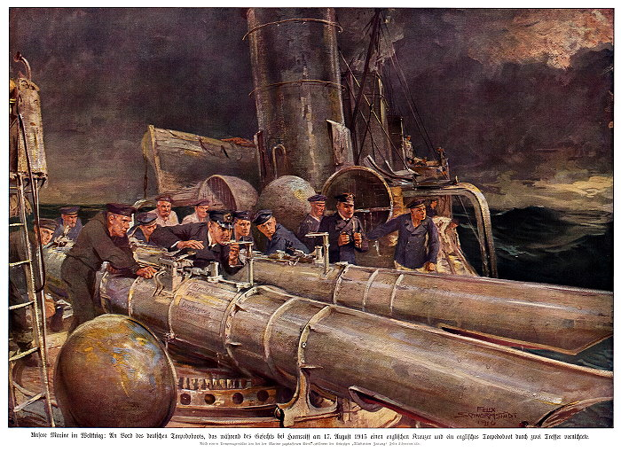
4.THE TURN AWAY
- The two battle lines parallel each other. The only hope of getting away is for a suicidal torpedo attack on the british line.
- Jellicoe turns his ships away. His ships and the torpedos would not meet at high speed and the stern profile but smaller than a broadside.
- Admiral Scheer’s tactic worked. Jellicoe lost contact.

Slide 13
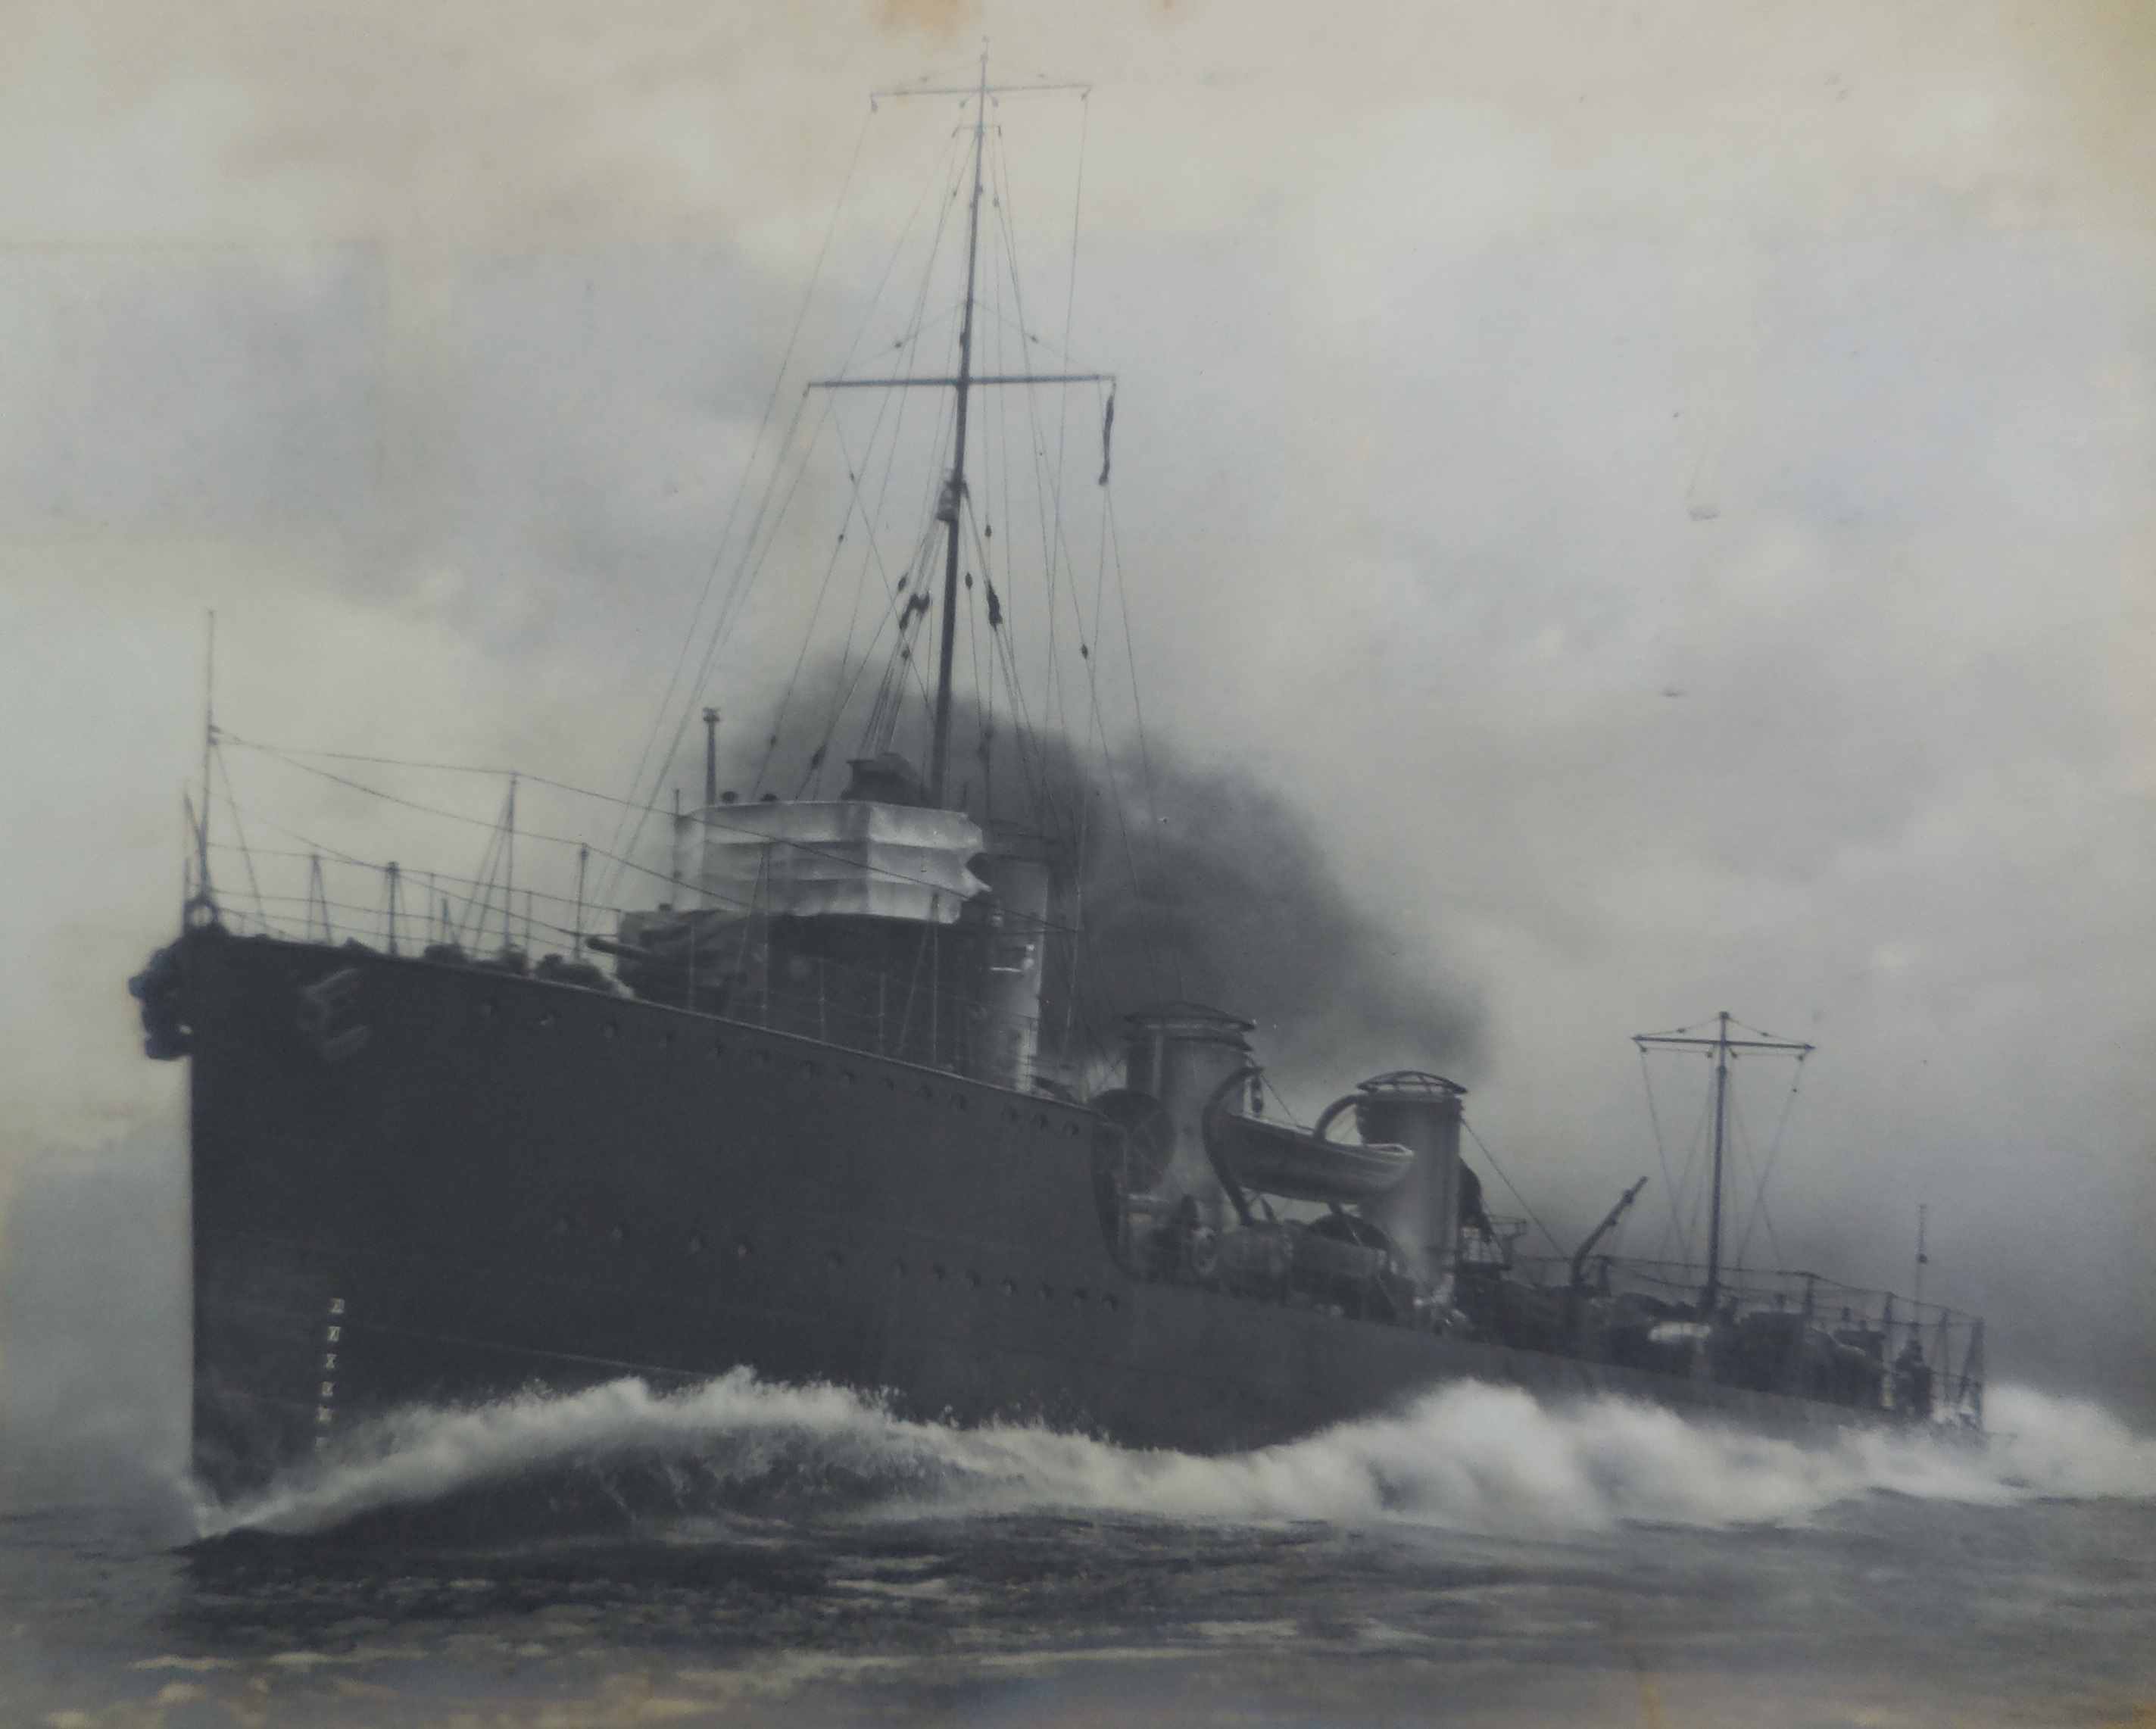
5.THE NIGHT ACTIONS-
- The Germans have to break through Jellicoe’s ships to get to the safety of their harbours.
- Scheer knows from intercepted signals that the gap between the dreadnoughts and the rear destroyer screens is the weak spot

Slide 14
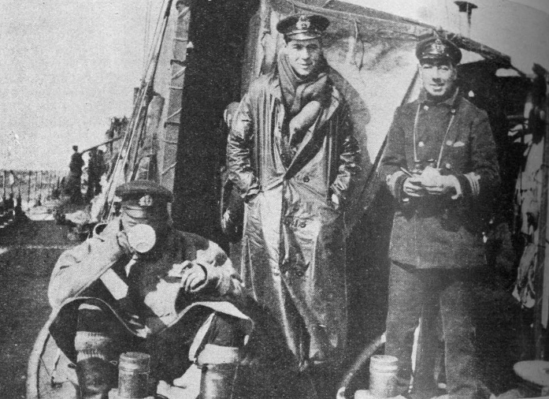
5.THE NIGHT ACTIONS-
- There are 7 savage – but unsuccesful - night engagements between 1,000 ton british destroyers and 20,000 German dreadnoughts
- Jellicoe is informed of these by local commanders nor by the Admiralty of the intelligence showing that
Scheer has chosen the short route home.

Slide 15
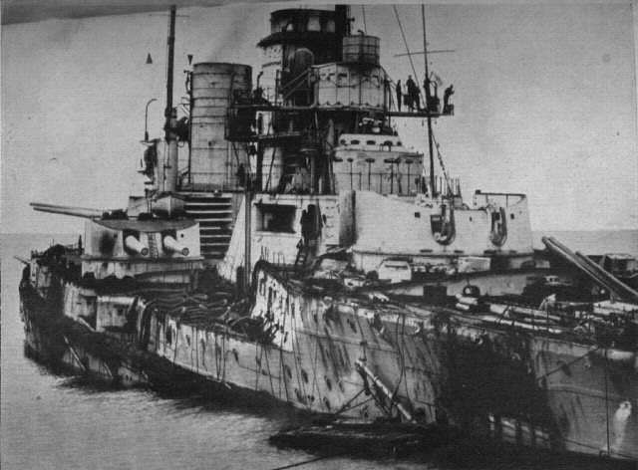
LOSSES HEAVIER FOR THE BRITISH
- 5,672 British and 2,115 German sailors killed
- Four Admirals killed in action

Slide 16
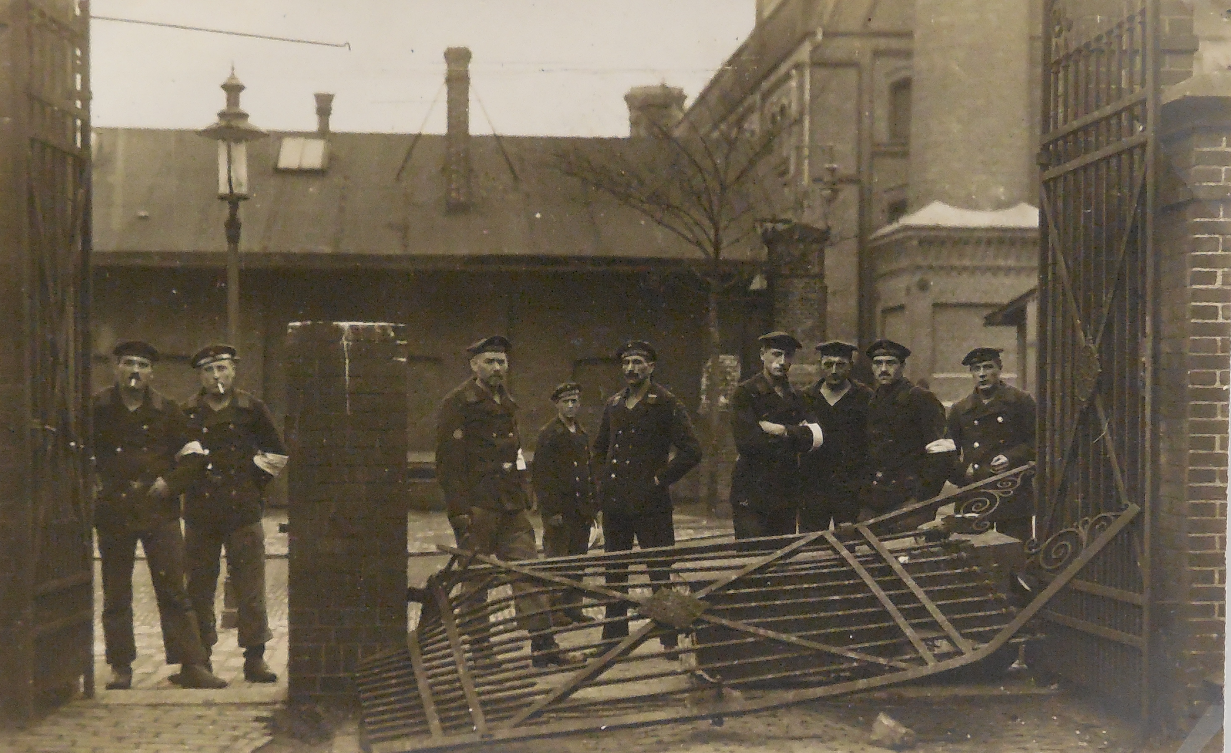
THE GERMAN REVOLUTION
- After Jutland the fleet only sortied once
- Morale collapsed and the navy mutinied
- Germany fell into a larger political revolution

Slide 17
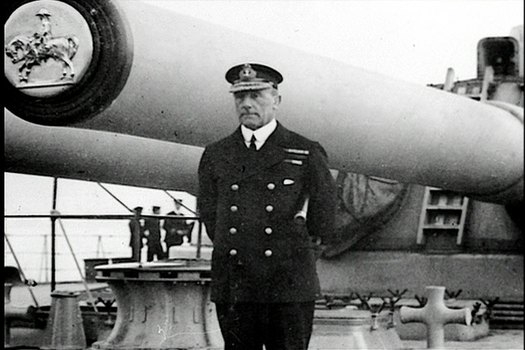
JUTLAND’S OUTCOME
- The Royal Navy maintained surface control
- The submarine peril was defeated
- Absence of annihilation encouraged reform

